Slide 1

Bank Loan Analysis

Slide 2

P .Jithendra Reddy
A. Santhi Priya
K. Sukanya
MB . Arpitha
B. Uma Maheshwari
G. Harashavardan
P_455 - Group 2 (Project Team Members)
P .Jithendra Reddy
K. Sukanya
MB . Arpitha
B. Uma Maheshwari
B. Srikanth
Chaitra

Slide 3

AGENDA
Objectives
KPI’s
Insights & recommendation
Conclusion

Slide 4

OBJECIVE
Loan analysis is to ensure that the loan application and approval process with regulatory requirements and internal polices and to determine the appropriate loan amount, interest rate, and repayment terms based on the borrower's financial situation and credit risk.

Slide 5



KPI’s
Year wise loan amount
Grade and sub grade wise revol bal
Total payment for verification Status
State wise loan status
Month wise loan status
KPI’s
KPI’s

Slide 6
YEAR WISE LOAN AMOUNT
There are 3 types of loan status Charged off, current and fully paid in Year wise Loan amount.
From which 2011 year has highest no. of fully paid accounts(198M), Current accounts and charged off accounts.
Where 2010 year has 106M fully paid accounts

Slide 7
GRADE AND SUB GRADE WISE REVOL BAL
GRADE AND SUB GRADE
WISE REVOL_BAL
There are different grades like A,B,C,D,E,F and G and the sub grades are A1,A2,A3,B1,B2,B3 and etc.,
Here we can see Details like grade and sub gradewide Revolve Balance.
Upon analyzing the revolving balance across different grades and subgrades, the grade B3 has highest revolve balance of 40M. Here the grade B3 indicates the financial stability and creditworthy.
KPI’s

Slide 8
TOTAL PAYMENT FOR VERIFICATION STATUS
The verification status are Verified, Not verified and Sourced verified.
Here we are comparing the verified and not verified status payment ,the total Payment is $373M.
The verified status has an highest of $220M this indicates the borrowers verified status are more likely to make payments on time and the not verified status has $154M Payments.
$ 373 M
Total Payment
KPI’s

Slide 9
Month wise Loan status of Top 5 States
The top 5 States are CA,FL,NJ,NY and TX displays the highest ‘last_credit_pull_d’ values .
This indicates that borrowers from these top 5 states tend to have more credit pull activities.
The state California(CA) has around $7.099k highest ‘last_credit_pull_d’ values among all the states. This indicates that borrowers in California tend to have the most recent credit pull activities when compared to other states.
Month wise Loan status of Top 5 States

Slide 10
Home Ownership Vs Last Payment Date Stats
This KPI indicates Year wise Home Ownership Vs last payment date status.
The Home Ownerships are Rent, Mortgage, Own and Others.
For Mortgage Total payment amount is $224M in percentage it is 50.29%,and the others has least loan amount of $1M in percentage it is 0.23
Home Ownership
Vs
Last Payment Date Stats

Slide 11
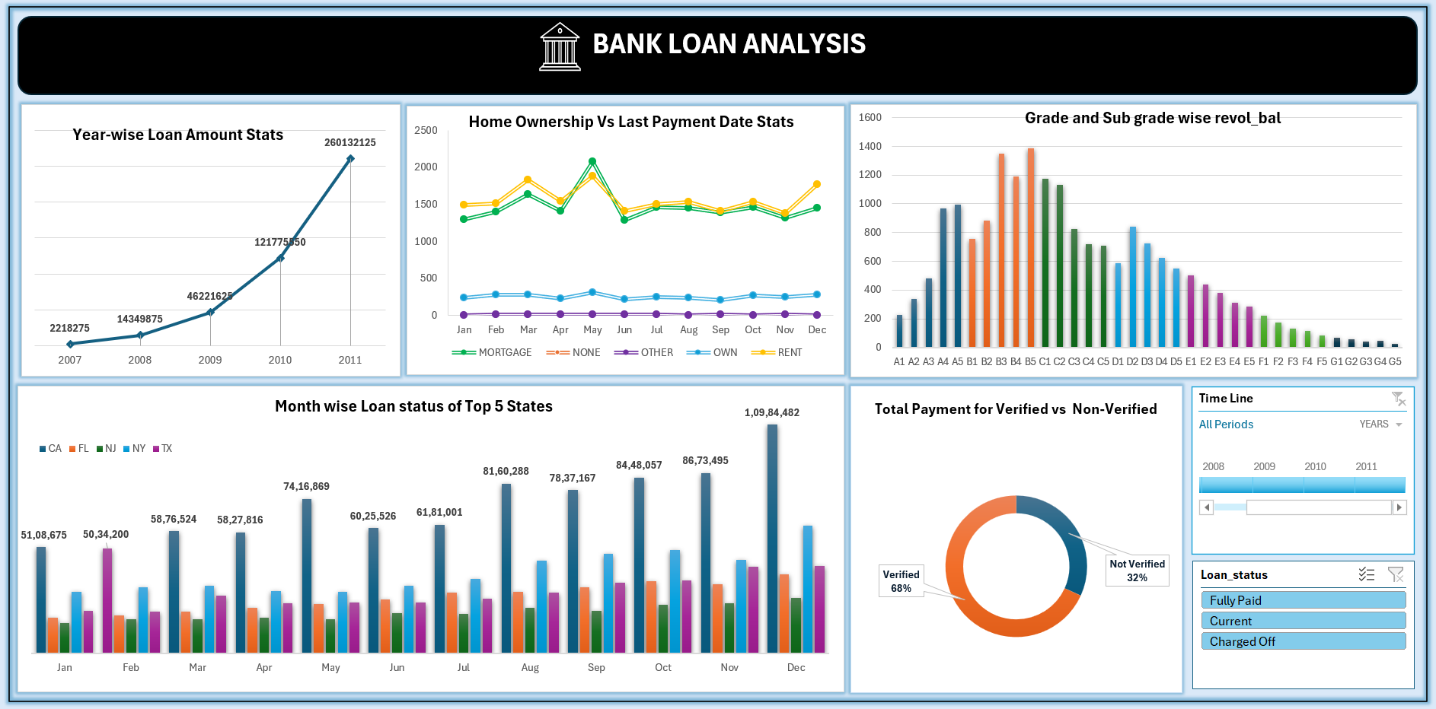

Slide 12

INSIGHTS AND SUGGESTIONS
Analyzing loan application data and approval rates can reveal trends in consumer behavior, economic conditions, and competitive dynamics. Analysis helps bank's identity and quantify the risks associated with lending to specific borrowers or sectors.
Verified accounts have a higher percentage of total payments, including that borrowers with verified status are more likely to make payments on time or in full. Understanding the profitability of different loan products and customer segments helps banks optimize pricing strategies and product offerings.

Slide 13

Conclusion
In conclusion, bank loan analysis is a critical process that provides valuable insights into the creditworthiness of borrowers, the risk profile of loans, and the overall health of a bank’s loan portfolio.
The conclusions drawn from this analysis serve as a crucial tool for informed decision making, risk assessment, and strategic planning within the banking sector and the broader financial ecosystem.
Effective loan analysis not only safeguards the bank’s financial interests but also enhances customer relationships by offering tailored financial solutions and support.

Slide 14


